Slide 1
Pointers
Lecturer: Nadia Binte Asif

Slide 2
Intro
Information → Mem location
Mem location→ Address
printf("Address of var1 variable: %x\n", &var1 );
Address of var1 variable: bff5a400

Slide 3
Pointers
Variable whose value is the address of another variable
Direct Address of mem loc
Whatever maybe the type
→long hexadecimal number
→What data it points
type *var-name;
8 bytes for a 64-bit System
4 bytes for a 32-bit System
int *ip; /* pointer to an integer */
double *dp; /* pointer to a double */
float *fp; /* pointer to a float */
char *ch; /* pointer to a character */

Slide 4
#include <stdio.h>
int main () {
int var = 20; /* actual variable declaration */
int *ip; /* pointer variable declaration */
ip = &var; /* store address of var in pointer variable*/
printf("Address of var variable: %x\n", &var ); /* address stored in pointer variable */
printf("Address stored in ip variable: %x\n", ip ); /* access the value using the pointer */
printf("Value of *ip variable: %d\n", *ip );
return 0;
}
Address of var variable: bffd8b3c
Address stored in ip variable: bffd8b3c
Value of *ip variable: 20
Dereference
When used in declaration (int* ptr), it creates a pointer variable.
When not used in declaration, it act as a dereference operator.

Slide 5
Pointers
Always use NULL assignment
Mem address ‘0’ is restricted
Reserved for sp. Purpose by OS
Null → Points to nothing.
Usage: Graph, trees, lists and Files
Caution → Damage to data in mem.
int *ptr = NULL;

Slide 6
Pointers Arithmetic
Increment and Decrement
ptr++
4bytes incr or dcr
1004 or 968
Moves the pointer to next/prev location without impacting the actual value at the mem. Loc.
Incases of character → 1001

Slide 7
#include <stdio.h>
const int MAX = 3;
int main () {
int var[] = {10, 100, 200};
int i, *ptr;
/* let us have array address in pointer */
ptr = var;
for ( i = 0; i < MAX; i++) {
printf("Address of var[%d] = %x\n", i, ptr );
printf("Value of var[%d] = %d\n", i, *ptr );
/* move to the next location */
ptr++;
}
return 0;
}
OUTPUT
Address of var[0] = bf882b30
Value of var[0] = 10
Address of var[1] = bf882b34
Value of var[1] = 100
Address of var[2] = bf882b38
Value of var[2] = 200

Slide 8
#include <stdio.h>
const int MAX = 3;
int main () {
int var[] = {10, 100, 200};
int i, *ptr;
/* let us have array address in pointer */
ptr = var;
for ( i = 3; i < = MAX; i--) {
printf("Address of var[%d] = %x\n", i-1, ptr );
printf("Value of var[%d] = %d\n", i-1, *ptr );
/* move to the previous location */
ptr--;
}
return 0;
}
OUTPUT
Address of var[2] = bfedbcd8
Value of var[2] = 200
Address of var[1] = bfedbcd4
Value of var[1] = 100
Address of var[0] = bfedbcd0
Value of var[0] = 10

Slide 9
Accessing Values
int* pc, c;
c = 5;
pc = &c;
c = 1;
printf("%d", c); // Output: 1
printf("%d", *pc); // Ouptut: 1
int* pc, c;
c = 5;
pc = &c;
*pc = 1;
printf("%d", *pc); // Ouptut: 1
printf("%d", c); // Output: 1

Slide 10
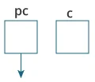
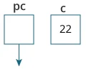
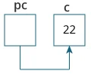
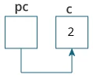
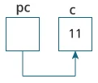
#include <stdio.h>
int main() {
int* pc, c;
c = 22;
printf("Address of c: %p\n", &c);
printf("Value of c: %d\n\n", c); // 22
pc = &c;
printf("Address of pointer pc: %p\n", pc);
printf("Content of pointer pc: %d\n\n", *pc); // 22
c = 11;
printf("Address of pointer pc: %p\n", pc);
printf("Content of pointer pc: %d\n\n", *pc); // 11
*pc = 2;
printf("Address of c: %p\n", &c);
printf("Value of c: %d\n\n", c); // 2
return 0;
}
Address of c: 2686784
Value of c: 22
Address of pointer pc: 2686784
Content of pointer pc: 22
Address of pointer pc: 2686784
Content of pointer pc: 11
Address of c: 2686784
Value of c: 2

Slide 11
%p or %x ??
The %p is used to print the pointer value, and %x is used to print hexadecimal values.
If we want to print some value using %p and %x then we will not feel any major differences.
The only difference that can be noticed is that the %p will print some leading zeros, but %x doesn’t.

Slide 12
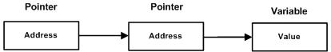
Pointer to Pointer
Chain of pointers
When we define a pointer to a pointer, the first pointer contains the address of the second pointer, which points to the location that contains the actual value as shown below.
int **var;

Slide 13
Pointer to Pointer
#include <stdio.h>
int main () {
int var;
int *ptr;
int **pptr;
var = 3000; /* take the address of var */
ptr = &var; /* take the address of ptr using address of operator & */
pptr = &ptr; /* take the value using pptr */
printf("Value of var = %d\n", var );
printf("Value available at *ptr = %d\n", *ptr );
printf("Value available at **pptr = %d\n", **pptr);
return 0;
}
Value of var = 3000
Value available at *ptr = 3000
Value available at **pptr = 3000

Slide 14
#include <stdio.h>
/* function declaration */
double getAverage(int *arr, int size);
int main () {
/* an int array with 5 elements */
int balance[5] = {1000, 2, 3, 17, 50};
double avg;
/* pass pointer to the array as an argument */
avg = getAverage( balance, 5 ) ;
/* output the returned value */
printf("Average value is: %f\n", avg );
return 0;
}
double getAverage(int *arr, int size) {
int i, sum = 0;
double avg;
for (i = 0; i < size; ++i) {
sum += arr[i];
}
avg = (double)sum / size;
return avg;
}
Average value is: 214.40000

Slide 15
Write a program in C to demonstrate the use of the &(address of) and *(value at address) operators.
Write a program in C to add two numbers using pointers.
Write a program in C to add numbers using call by reference.
Write a program in C to find the maximum number between two numbers using a pointer.
Write a program in C to store n elements in an array and print the elements using a pointer
Write a program in C to find the factorial of a given number using pointers.

Slide 16
#include <stdio.h>
void swap_nums(int *x, int *y)
{
int tmp;
tmp = *x;
*x = *y;
*y = tmp;
}
void swap_pointers(char *x, char *y)
{
char *tmp;
tmp = x;
x = y;
y = tmp;
}
FIND the OUTPUT

Slide 17
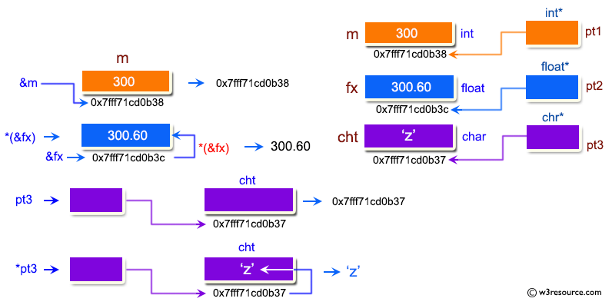
Pointer : Demonstrate the use of & and * operator :
--------------------------------------------------------
m = 300
fx = 300.600006
cht = z
Using & operator :
-----------------------
address of m = 0x7fff71cd0b38
address of fx = 0x7fff71cd0b3c
address of cht = 0x7fff71cd0b37
Using & and * operator :
-----------------------------
value at address of m = 300
value at address of fx = 300.600006
value at address of cht = z
Using only pointer variable :
----------------------------------
address of m = 0x7fff71cd0b38
address of fx = 0x7fff71cd0b3c
address of cht = 0x7fff71cd0b37
Using only pointer operator :
----------------------------------
value at address of m = 300
value at address of fx= 300.600006
value at address of cht= z

Slide 18
#include <stdio.h>
void main()
{
int m=300;
float fx = 300.60;
char cht = 'z';
printf("\n\n Pointer : Demonstrate the use of & and * operator :\n");
printf("--------------------------------------------------------\n");
printf("\n Using & and * operator :\n");
printf("-----------------------------\n");
printf ( " value at address of m = %d\n",*(&m));
printf ( " value at address of fx = %f\n",*(&fx));
printf ( " value at address of cht = %c\n",*(&cht));
printf("\n Using only pointer variable :\n");
printf("----------------------------------\n");
printf ( " address of m = %p\n",pt1);
printf ( " address of fx = %p\n",pt2);
printf ( " address of cht = %p\n",pt3);
printf("\n Using only pointer operator :\n");
printf("----------------------------------\n");
printf ( " value at address of m = %d\n",*pt1);
printf ( " value at address of fx= %f\n",*pt2);
printf ( " value at address of cht= %c\n\n",*pt3);
}
int *pt1;
float *pt2;
char *pt3;
pt1= &m;
pt2=&fx;
pt3=&cht;
printf ( " m = %d\n",m);
printf ( " fx = %f\n",fx);
printf ( " cht = %c\n",cht);
printf("\n Using & operator :\n");
printf("-----------------------\n");
printf ( " address of m = %p\n",&m);
printf ( " address of fx = %p\n",&fx);
printf ( " address of cht = %p\n",&cht);

